Slide 1

Use-case-driven architecture
Arturs Karbone
22-Feb-2018
https://www.linkedin.com/in/arturkarbone/
Training http://devchampions.com/training/unit_and_integration_testing/
Blog http://craftsmanatwork.guru/

Slide 2
They are Kind of about the same
Architecture in Slices (J. Bogard)
Screaming/Clean Architecture (Uncle Bob)
Feature-Driven/Use-Case-Driven (A.Karbone & friends)
Architecture of common sence (A.Karbone & friends)

Slide 3
The typical solution I see. 1st issue
Includes 30+ projects
159 projects per solution (personal records)
Projects named: *.DALs, *.BALs, *.Helpers, *.Services,*.Common, *.Migrators of any kinds
Build & Run from F5 or a single script ? Forget about it
Sane Development Practices?

Slide 4
The typical Project structure I see. 2nd issue
Where is freaking entry point? Where should I start?
Controllers
Views
Models
Managers
Services
Interfaces (of course)

Slide 5
The typical trend i see. 3rd issue
Fancy frameworks at 1st place
Business at 2nd (my very OPTIMISTIC opinion)
«Button» thinking

Slide 6
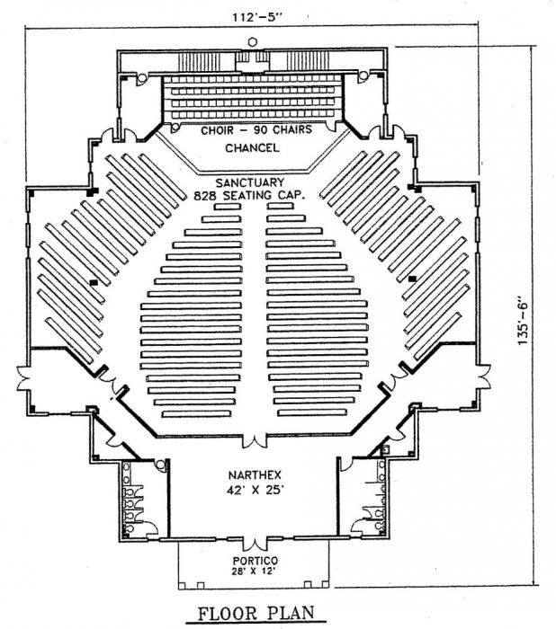

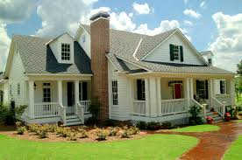
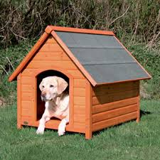
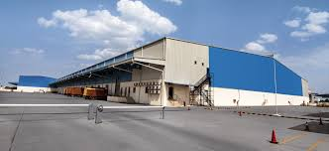
Building Architects solved this problems

Slide 7
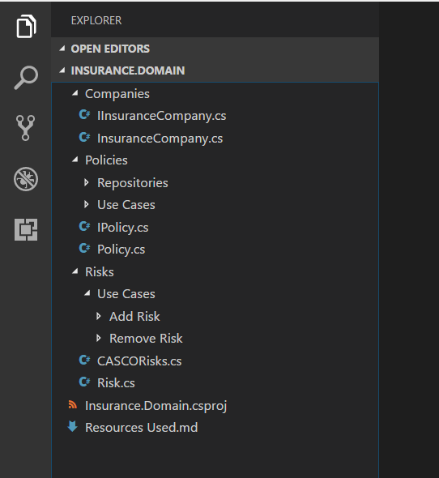
Can software architecture scream about the intent?
I think so

Slide 8
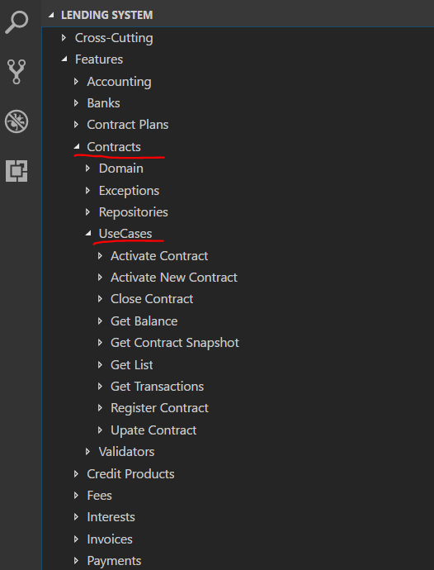
Can software architecture scream about the intent?

Slide 9
Anatomy of business process
Input data
Actions
Results

Slide 10
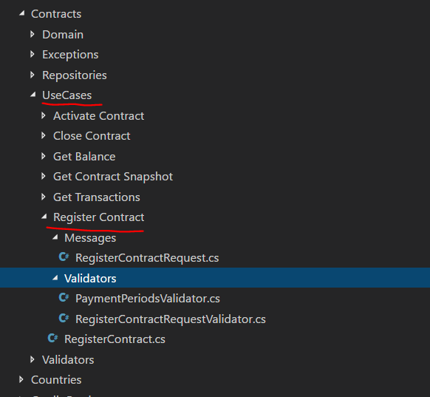
Anatomy of Use-case

Slide 11
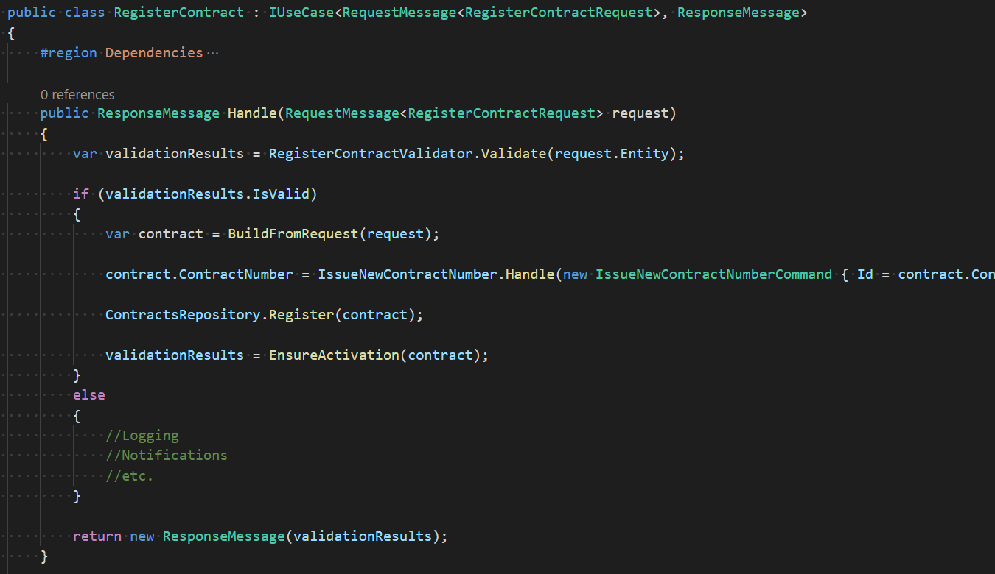
Anatomy of Use-case

Slide 12
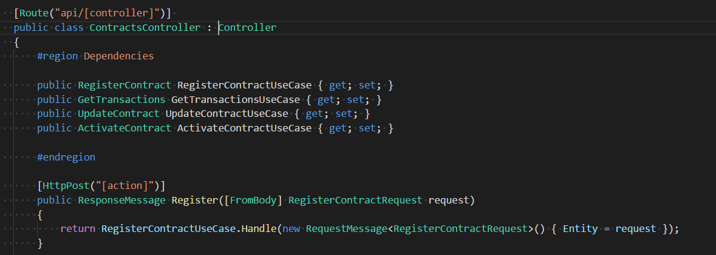
One liners in content delivery mechanisms

Slide 13
LOB Application structure = Use-cases + content delivery mechanisms
Frontend
ETC.
Use-cases
SignalR
Content delievery channels
API
Messaging

Slide 14
Roles
Use cases reflect business logic
Content Delivery channels – oneliners calling use cases

Slide 15
Ideal Number of projects in the solution
One for all the Use Cases
One per a Content Delivery channel

Slide 16
BenEfits
Business logic in one place
Wrap use case with an additional cross-cutting logic
Logging
Performance Logging
Wrap with additional context (Autofac/Correlation ID for Masstransit Consumers)

Slide 17
Takeaways
Focus on what matters
We still have to follow frameworks trend (unfortunatelly)
PhD in Getting Shits Done
Business thinking via Use-Cases/Features
It was possible to write this way 20 years ago
It will be actual in 20 years
Ship it!

Slide 18
Resource
SOLID architecture in Slices – https://vimeo.com/131633177
.NET Rocks! Fighting the Churn with Uncle Bob

Slide 19
Questions & discussions

